Slide 1


OBESITY MANAGEMENT MEDICATIONS: LINEE GUIDA
Dr. Matteo Monami
Careggi Teaching Hospital,
Firenze

Slide 2
Il Dr. M. Monami ha ricevuto speaking fees/grant da:
Boehringer
Lilly
Novonordisk
Biocomposites
Molteni
e da Società Scientifiche:
SICOB
IFSO
EASO
SIO
ESE

Slide 3
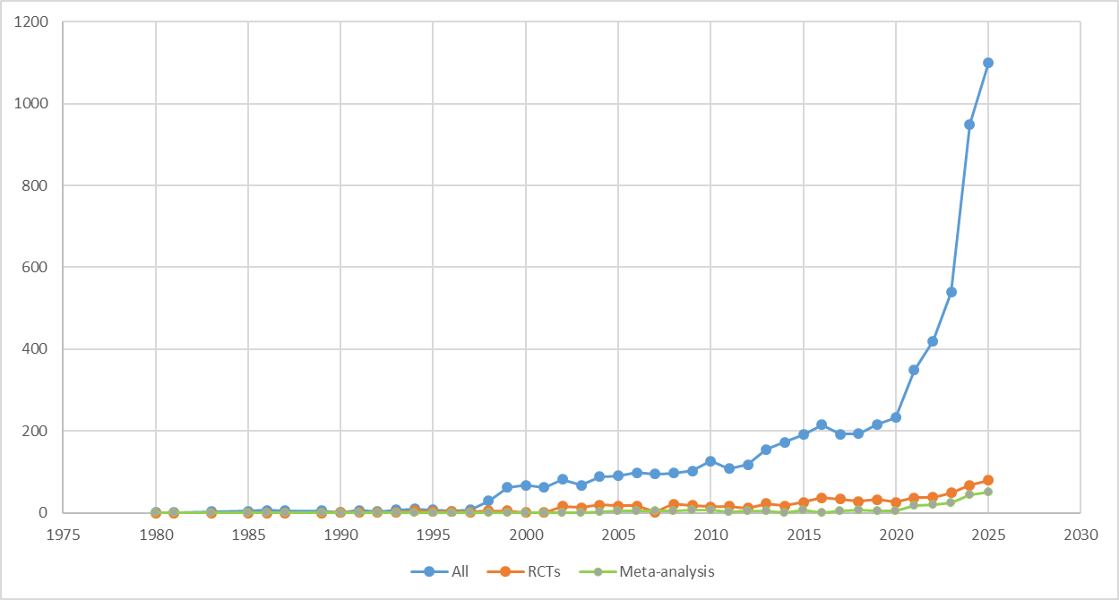
How to manage all this info?
Search string: (obesity or overweight) AND (orlistat OR naltrexone OR bupropion OR Liragl. OR Semagl. OR Tirzep. OR phentermine/topiramate)
Trials on OMM: 798 up to 24th, Oct 2025

Slide 4
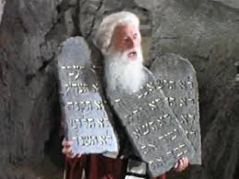
Pyramid of scientific evidence: efficacy and safety based on RCT

Slide 5
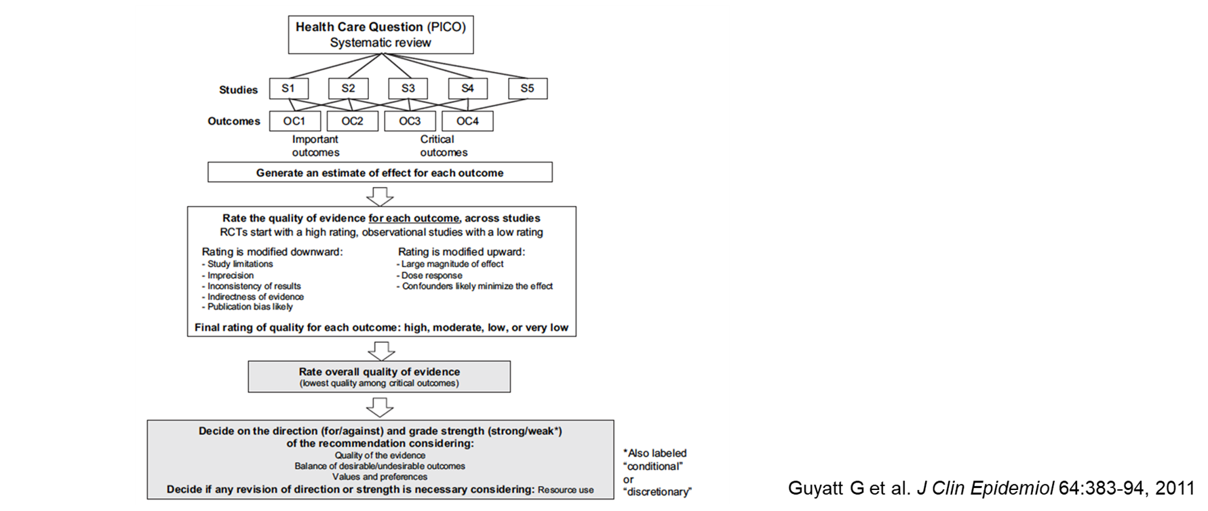
How to manage all this info?
GRADE
= Meta-analysis

Slide 6
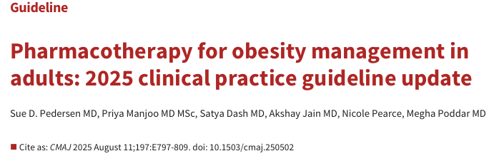
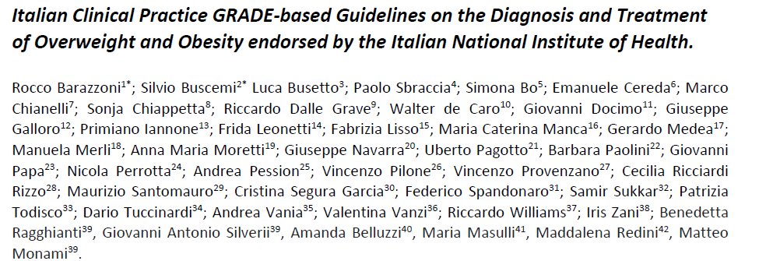
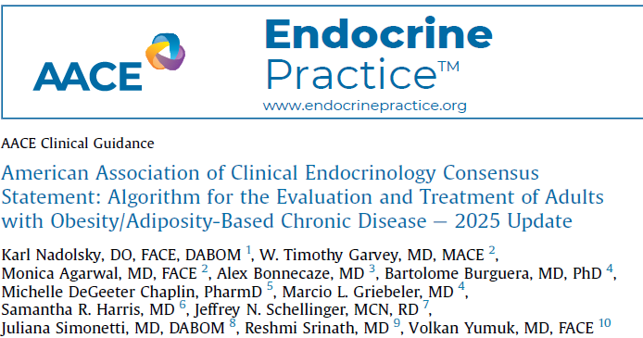
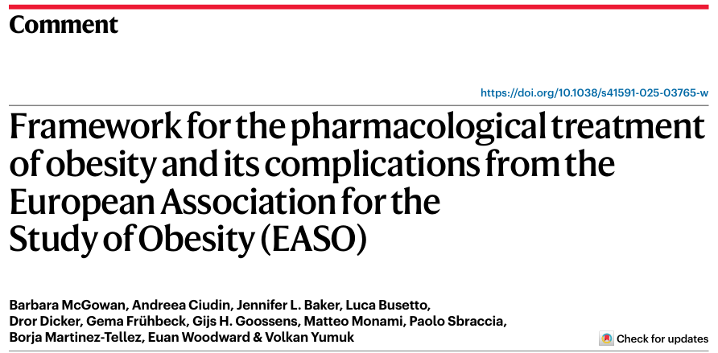
How to manage all this info?
Canadian³
SIO¹
AACE⁴
EASO²
¹Barazzoni R, et al., EWD, 2025; Manuscript submitted
²McGowan B, et al., Nat Med, 2025; 3229–3232
³Pedersen S, et al., CMAJ 2025; E797-809
⁴Nadolsky, et al., Endocrine Practice 2025; In press.

Slide 7
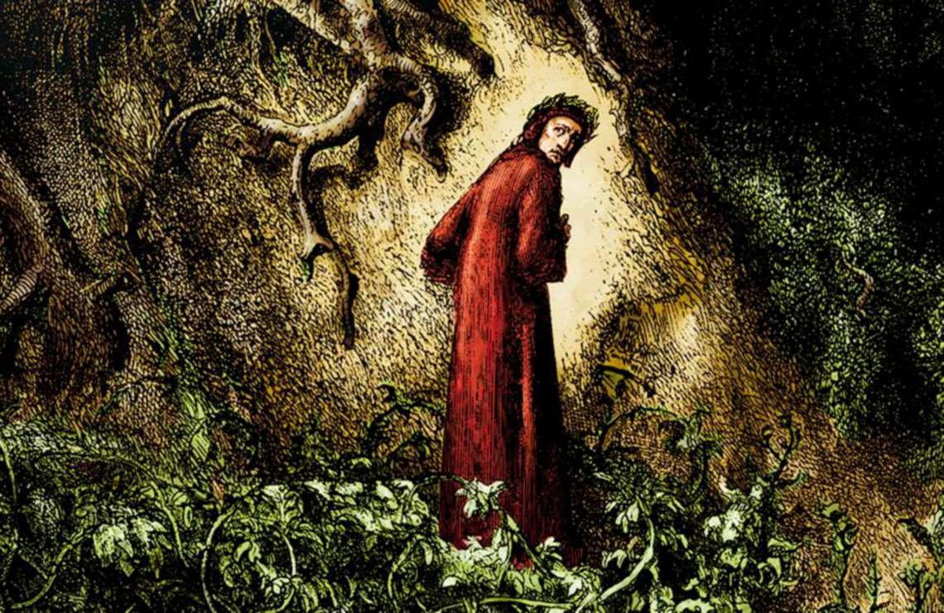
How to manage all this info?
Canadian³
SIO¹
AACE⁴
EASO²
¹Barazzoni R, et al., EWD, 2025; Manuscript submitted
²McGowan B, et al., Nat Med, 2025; 3229–3232
³Pedersen S, et al., CMAJ 2025; E797-809
⁴Nadolsky, et al., Endocrine Practice 2025; In press.

Slide 8


Methods
Characteristics | Canadian¹ | EASO² | AACE³ | SIO⁴
GRADE
Network Meta-analysis
Up to May 2025
RCT duration
ASCVD
Heart failure
Prediabetes/diabetes
MASH/MASLD
OSAS
OA
Hyperten./Dyslipid.
Surgical/Endos. options
¹Pedersen S, et al., CMAJ 2025; E797-809
²McGowan B, et al., Nat Med, 2025; 3229–3232
³Nadolsky, et al., Endocr Pract, 2025; In press
⁴Barazzoni R, et al., EWD, 2025; Manuscript submitted

Slide 9
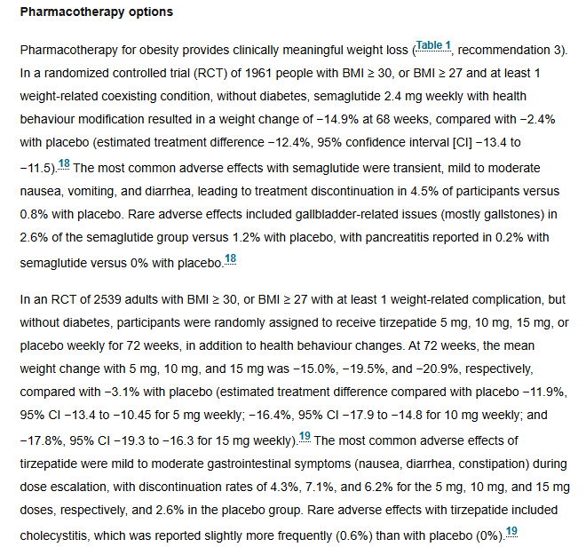
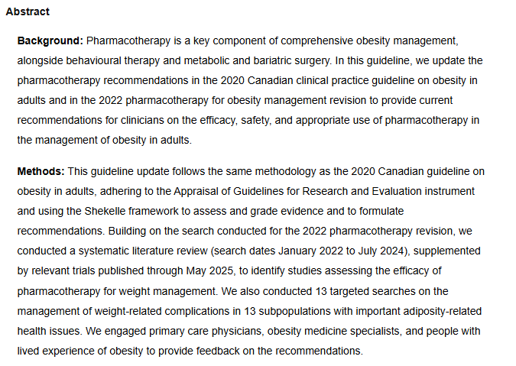
Body weight
Pedersen S, et al., CMAJ 2025; E797-809

Slide 10
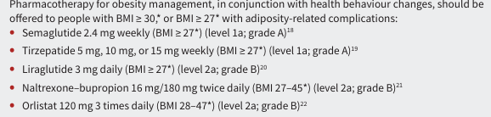
Body weight
Pedersen S, et al., CMAJ 2025; E797-809

Slide 11
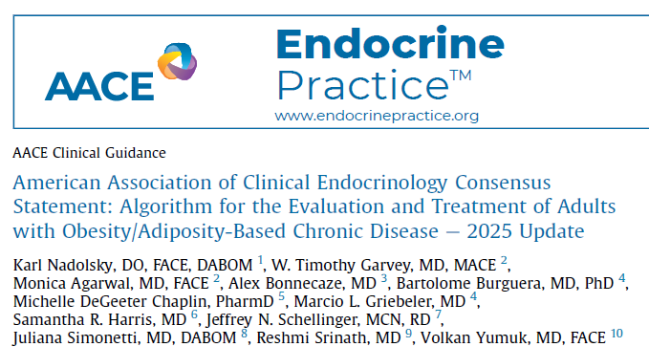
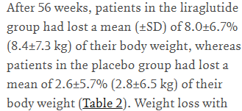
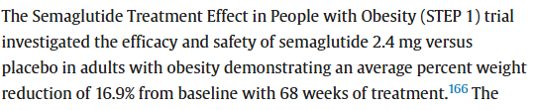
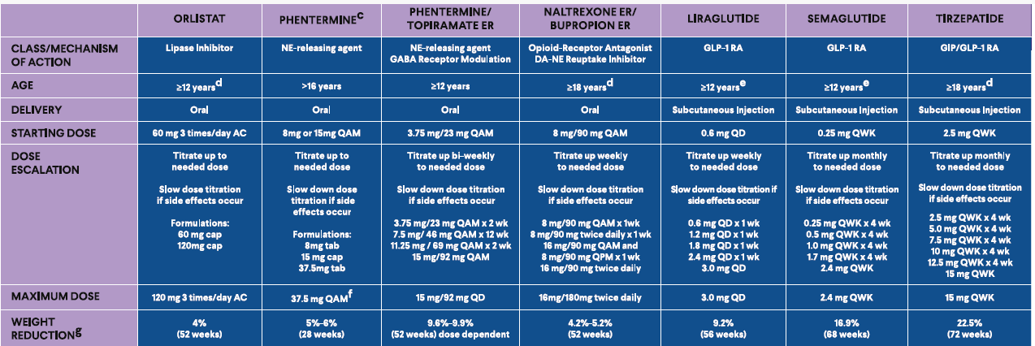


Body weight
?
?
Nadolsky, et al., Endocr Pract, 2025; In press

Slide 12
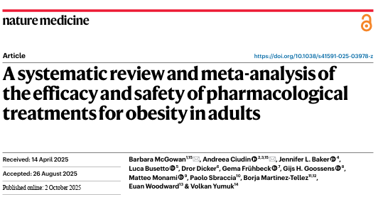
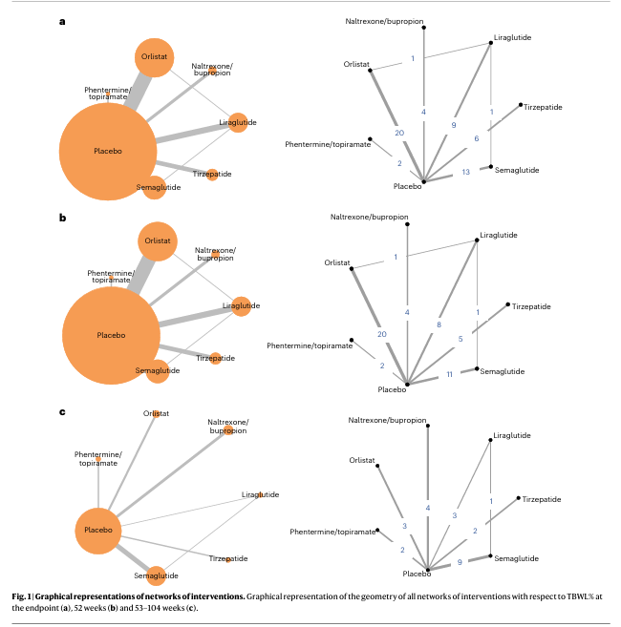
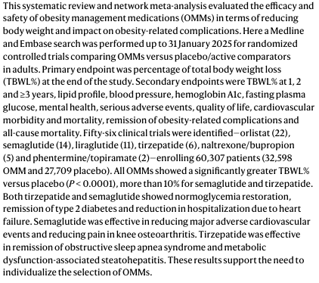
Body weight
McGowan B, et al., Nat Med, 2025; 3229–3232

Slide 13
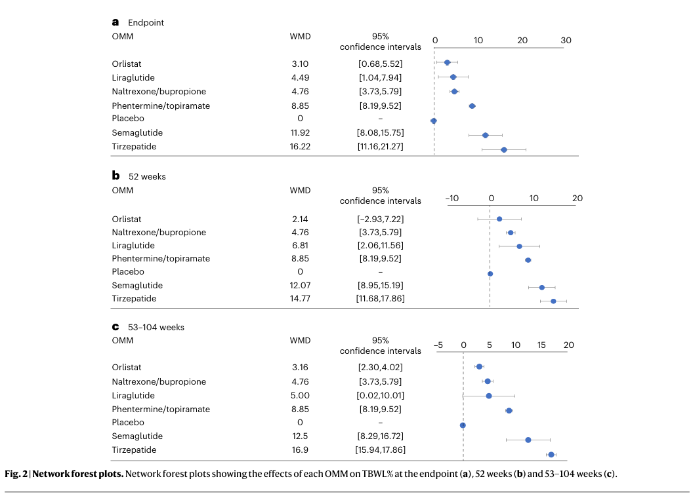
Body weight
McGowan B, et al., Nat Med, 2025; 3229–3232

Slide 14
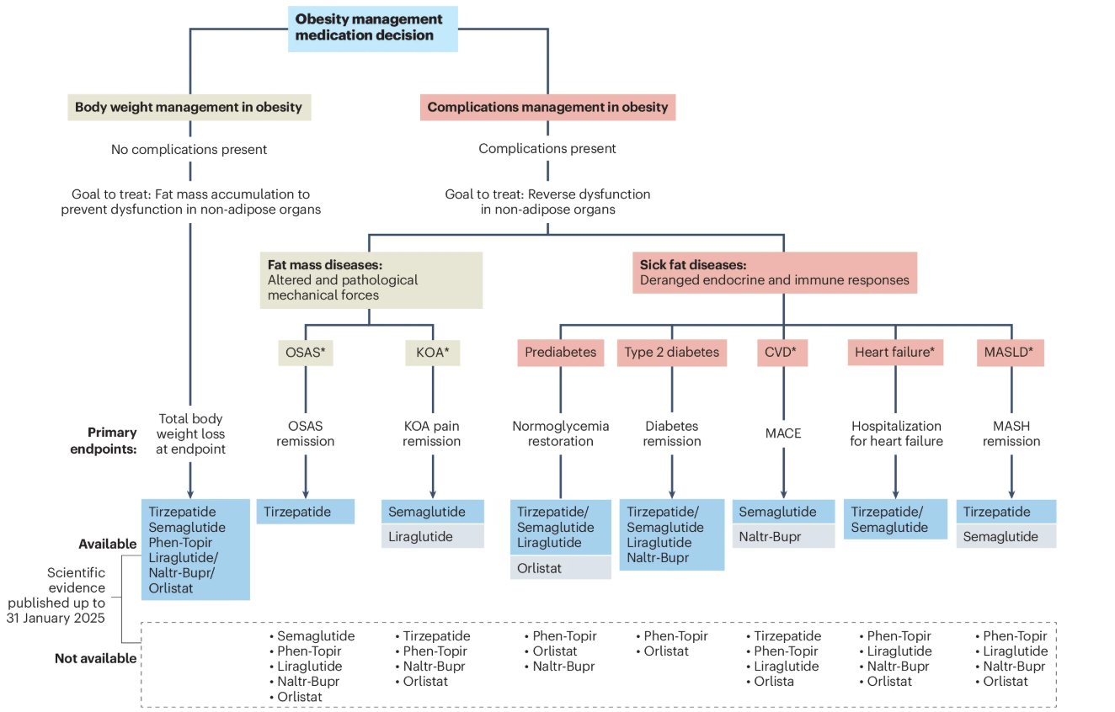
Body weight
McGowan B, et al., Nat Med, 2025; 3229–3232

Slide 15
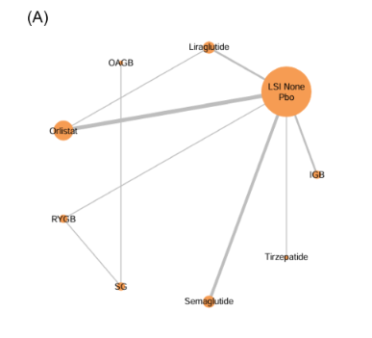
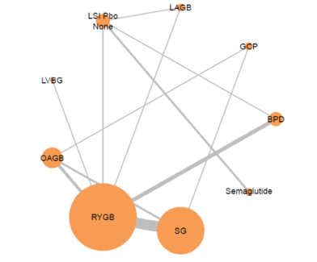
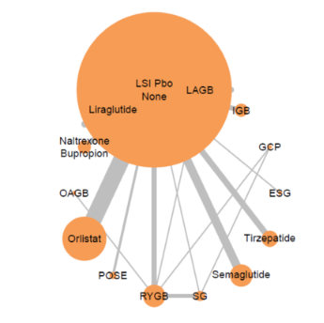
Class I obesity
Body weight
Class III obesity
Class II obesity
Barazzoni R, et al., EWD, 2025; Manuscript submitted

Slide 16
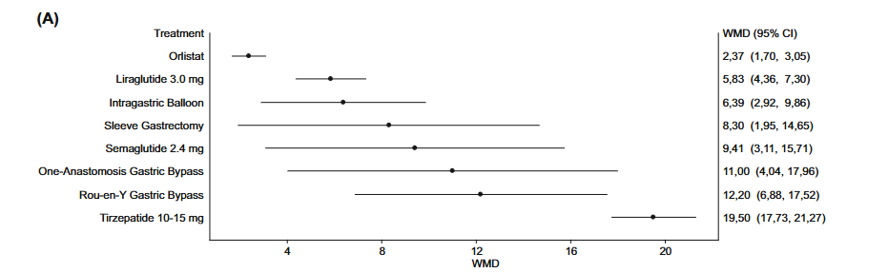
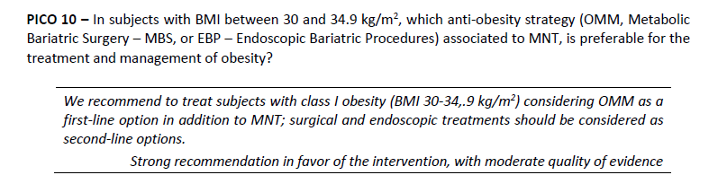
Class I obesity²
Body weight¹
¹Barazzoni R, et al., EWD, 2025; Manuscript submitted
²Barazzoni R, et al., Diab Obes Metab, 2025.

Slide 17
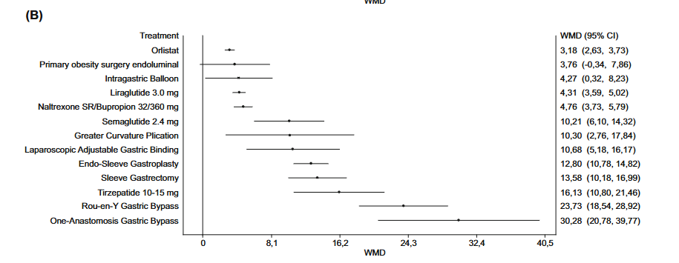
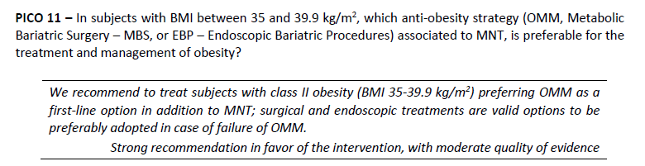
Class II obesity²
Body weight¹
¹Barazzoni R, et al., EWD, 2025; Manuscript submitted
²Barazzoni R, et al., Diab Obes Metab, 2025.

Slide 18
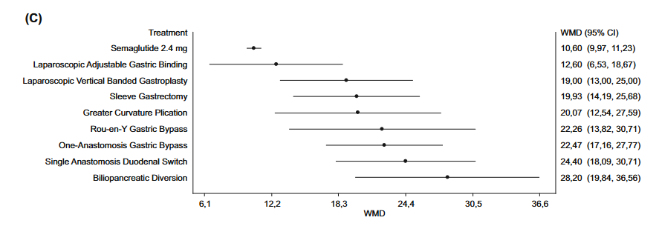
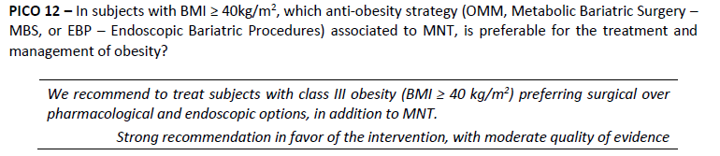
Class III obesity²
Body weight^{1,2}
¹Barazzoni R, et al., EWD, 2025; Manuscript submitted
²Barazzoni R, et al., Diab Obes Metab, 2025.

Slide 19
Class III obesity²
Body weight¹
¹Barazzoni R, et al., EWD, 2025; Manuscript submitted
²Barazzoni R, et al., Diab Obes Metab, 2025.

Slide 20
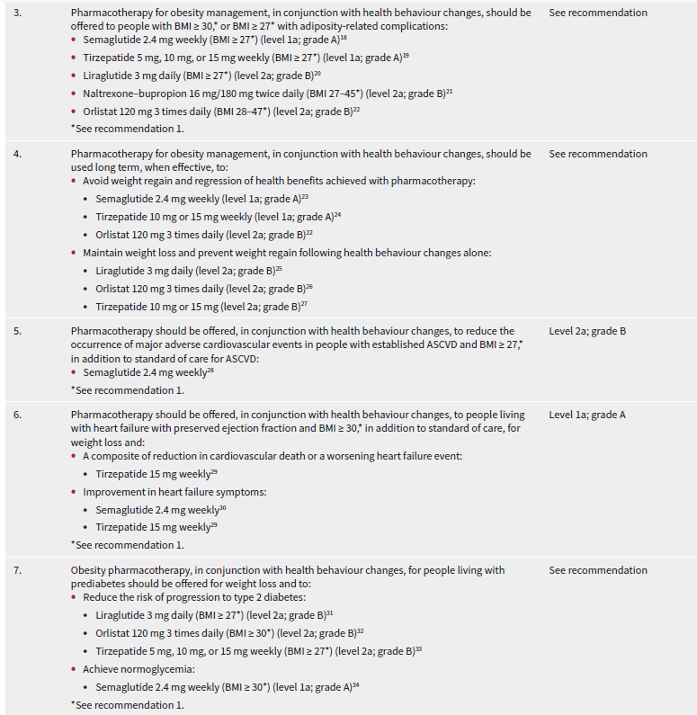
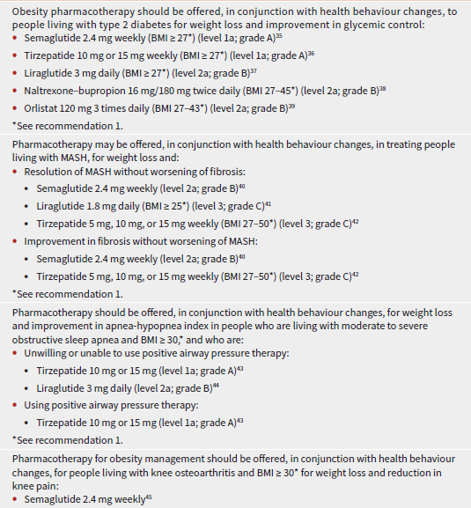
Pedersen S, et al., CMAJ 2025; E797-809

Slide 21
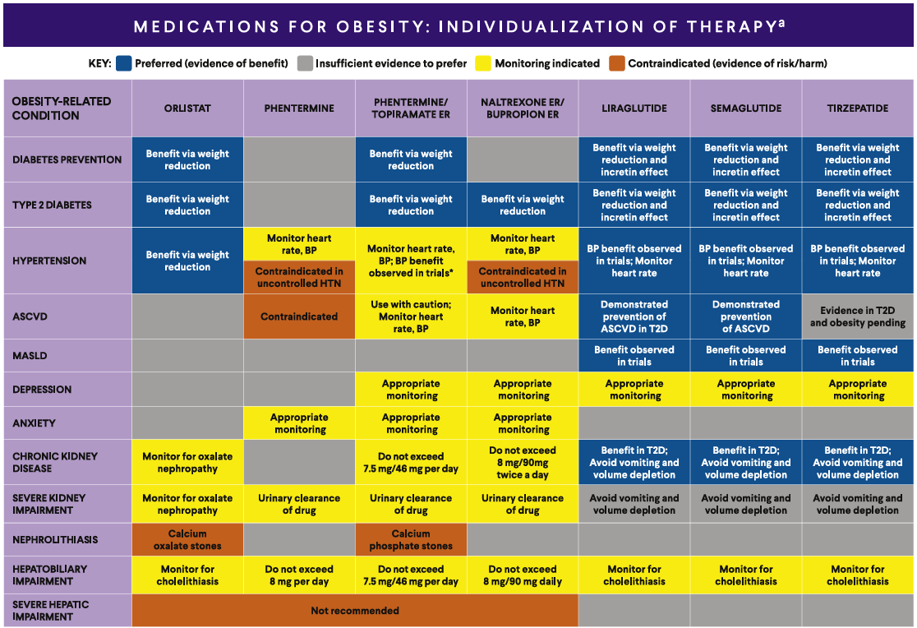
Nadolsky, et al., Endocr Pract, 2025; In press

Slide 22
McGowan B, et al., Nat Med, 2025; 3229–3232

Slide 23

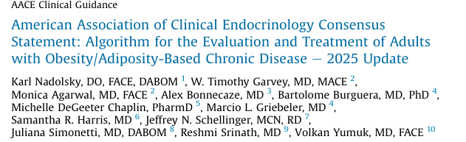


OMM across different Guidelines
Characteristics | Canadian | EASO | AACE
Cardiovascular disease | Semagl. | Semagl. Naltr./Bupr. | Semagl. Liraglutid.* PT/NB
Heart failure | Tirzep./Semagl. | Tirzep./Semagl. | Tirzep./Semagl.
Prediabetes | Lirag./Orlis./Tirzep./ Semag. | Tirzep./Semagl. Liragl. | Lirag./Orlis./Tirzep./ Semag.
Type 2 diabetes | Semag./Tirzep./NB/ Liragl./Orls. | Tirzep./Semagl. Liragl./NB | Semag./Tirzep./NB/ Liragl./Orls.
MASH/MASLD | Semag./Tirzep./Lirag. | Tirzep. Semagl. | Semag./Tirzep./Lirag.
Sleep apnea syndrome | Tirzep./Lirag. | Tirzep. | Tirzep./Lirag.
Knee osteoarthritis | Semagl. | Semagl. Liragl. | Semagl.
SIO
Semagl. (Overweight and Class I) Naltrexone/Bupropion (Class II)
Tirzep./Semagl. (Class II)
Lira/Orlistat (Class I) Semagl. (Class II)
Semagl. (Class I) Tirze/Sema/Lira/NB (Class II)
Tirzep. (Class II)
Tirzep. (Class II)
Semagl. (Class III)
*Type 2 diabetes

Slide 24
OMM across different Guidelines
Characteristics | Canadian | EASO | AACE
Cardiovascular disease | Semagl. | Semagl. Naltr./Bupr. | Semagl. Liraglutid.* PT/NB
Heart failure | Tirzep./Semagl. | Tirzep./Semagl. | ??
Prediabetes | Lirag./Orlis./Tirzep./ Semag. | Tirzep./Semagl. Liragl. | Lirag./Orlis./Tirzep./ Semag.
Type 2 diabetes | Semag./Tirzep./NB/ Liragl./Orls. | Tirzep./Semagl. Liragl./NB | Semag./Tirzep./NB/ Liragl./Orls.
MASH/MASLD | Semag./Tirzep./Lirag. | Tirzep. Semagl. | Semag./Tirzep./Lirag.
Sleep apnea syndrome | Tirzep./Lirag. | Tirzep. | ??
Knee osteoarthritis | Semagl. | Semagl. Liragl. | ??.
SIO
Semagl. (Overweight and Class I) Naltrexone/Bupropion (Class II)
Tirzep./Semagl. (Class II)
Lira/Orlistat (Class I) Semagl. (Class II)
Semagl. (Class I) Tirze/Sema/Lira/NB (Class II)
Tirzep. (Class II)
Tirzep. (Class II)
Semagl. (Class III)
*Type 2 diabetes

